Slide 1
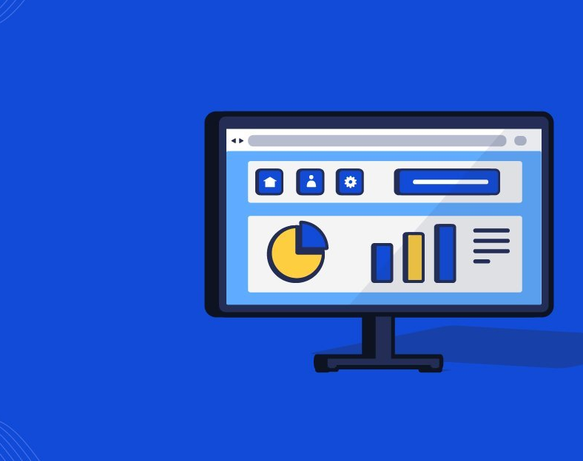


Web App 101
By Memona Haq

Slide 2
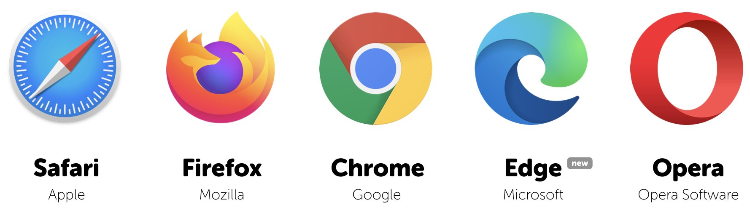
Web Applications (Apps)
Computer program
Web development technologies
Used with a browser
Over the Internet
Notes:
A web application is a computer program/interactive app built using web development technologies that users can access from their web browser to perform tasks over the internet.
All you need to do is access the web app through any web browser like Google Chrome, Firefox, Safari

Slide 3
Which browser do you use?
Notes:
It will be quite interesting to see which browser is the most famous amongst the people attending today

Slide 4
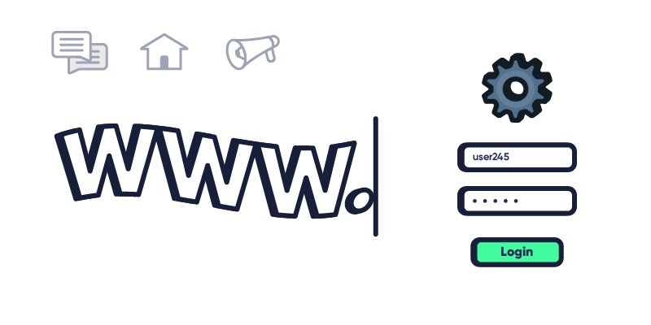
How it Works?
Notes:
Demand for web apps is increasing because they don’t even require a download
For any user to access a web app they need to know its URL and they can just get started in using the app through their browser.
You also need to be connected to the internet.

Slide 5
Website Vs. Web App Vs. Native App Vs. Hybrid App
Web Apps | Interactive
Websites | Present Information
Native apps | Built for specific platforms
Hybrid apps | Multi-platform compatibility
Notes:
Web apps operate on any device in a mode that is quite different than that of a traditional website.
Web apps are designed to be interactive whereas
The primary purpose of a website is to present information.
Distinguishing one from the other is can be a little tough at first, but once you start recognizing the difference you’ll see why it matters.
Then there are native and hybrid apps
Native apps are mobile apps that are specifically built for the platforms they run on.
So developers have to employ native technologies to use them — the Swift programming language for iOS, or the Java programming language for Android.
The disadvantage of native apps is that you’ll have to develop different apps for different platforms, as each app will require a different codebase in its native language.
Native apps definitely have their place, for example it is Good for game development as they require way more recourses than your typical web app
Hybrid apps provide a solution for quicker development. They take advantage of both native and web technologies and as a result, they can extend multi-platform compatibility.
Web apps are actually neither of these things. Web app developers solely make use of web technologies.
However, web applications place a certain focus on user interaction, just like a mobile app, and not like a traditional website at all.
Traditional websites may have users who scroll or click to consume more information, or they may even enter an email address or perhaps more personal information for an online purchase.
But a web app optimizes the user experience (UX) so users can do much more.
And web apps need be dynamically updated to handle these sorts of interactions.
For example, you’ll notice that using Twitter or Facebook from a web browser is a more captivating experience than clicking onto the website of for example PizzaHut
That’s because the former are web apps and the other is a website.

Slide 6
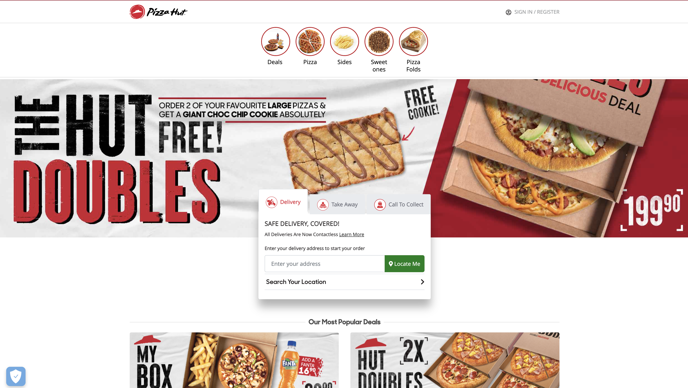
Website

Slide 7
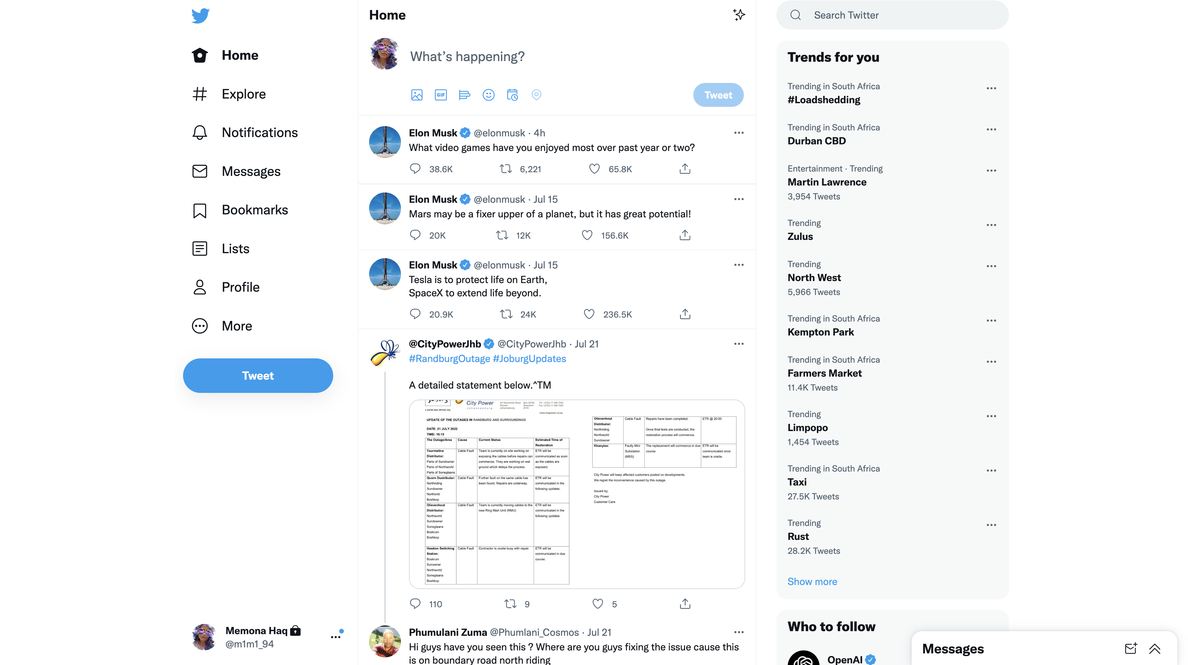
Web App

Slide 8
Exercise
Find an example of a Website and post it in the chat
Notes:
Ask to explain why they think its what it is

Slide 9
Exercise
Find an example of a Web App and post it in the chat
Notes:
Ask to explain why they think its what it is

Slide 10
Exercise
Find an example of a Native App and post it in the chat
Notes:
Ask to explain why they think its what it is

Slide 11
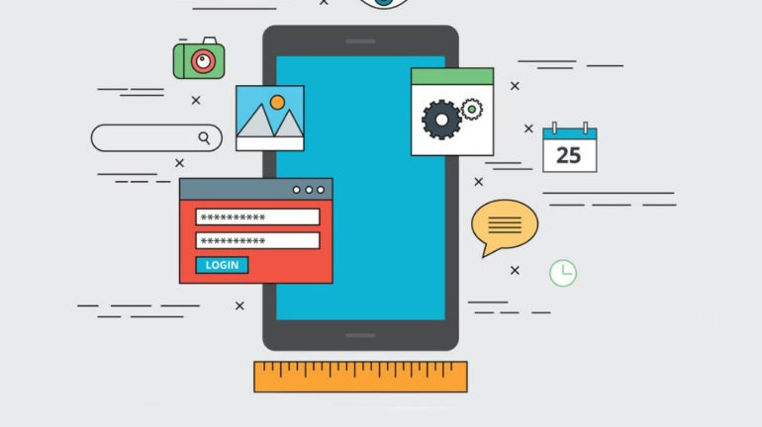
Progressive Web Apps (PWAs)
Combine features native and hybrid apps
Notes:
Progressive web apps (PWAs) are a particular type of web app that is fairly modern in the digital world.
PWAs combine desirable features of both native and hybrid apps.
Like any other web app, PWAs reside in a web browser.
Users can access them like any website.
Still, having a PWA means going through the classic download and install process that users expect with mobile apps.
But this is a good thing as PWAs can always be readily available from the user’s device.
Both the Google Play Store and the Microsoft Store welcome PWAs to their platform. So in some ways, a PWA is like a mobile app.
Progressive web apps launch from a user’s device without the need to open a web browser first and they can send push notifications directly to your mobile device.
They can also work offline and load quite quickly.
What makes PWAs so cool is their performance. Well web apps as a while are pretty cool to be honest, building one app to use on so many different devices.
But unfortunately people believe web apps and hybrid apps have slower performance than native apps.
Progressive web apps tend to defy this stereotype. Though it is important to keep in mind that PWAs do not intend to take mobile apps’ role.
PWAs are best defined as traditional websites in the packaging of a mobile app.

Slide 12

Can you think of any examples of PWAs?
Notes:
Uber
Pinterest
Spotify
Starbucks

Slide 13
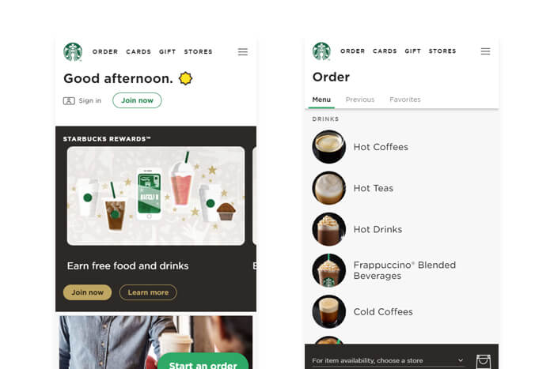
Starbucks

Slide 14
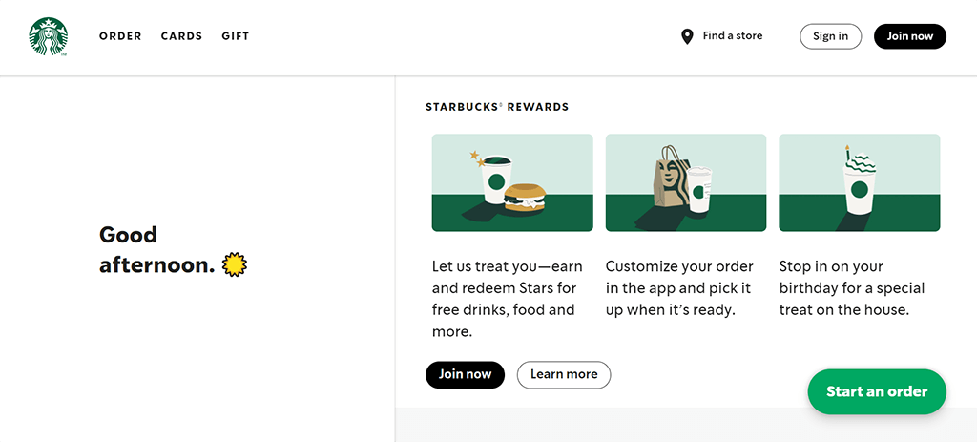
Starbucks

Slide 15
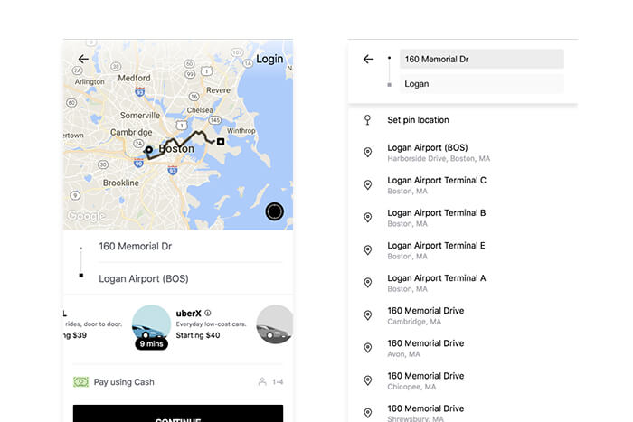
Uber

Slide 16
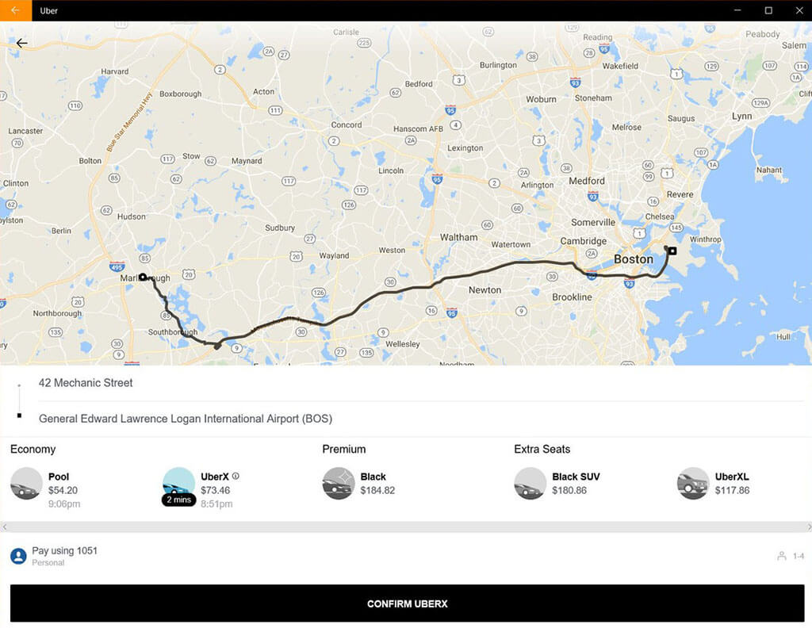
Uber

Slide 17
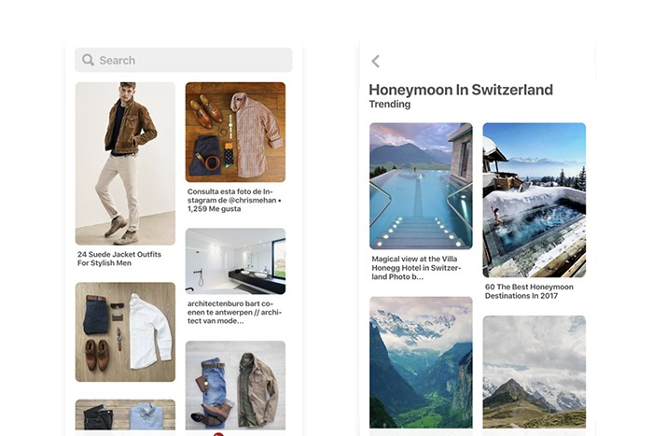
Pinterest

Slide 18
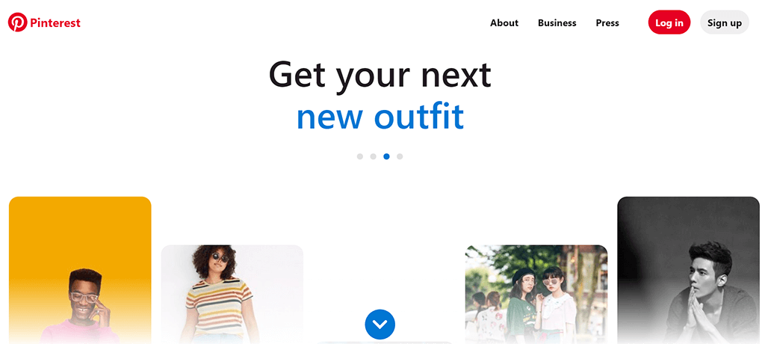
Pinterest

Slide 19

Advantages and Disadvantages of Web Apps
Notes:
Web-based applications ultimately ease the development process in a lot of ways.
Businesses can give their users interact with their apps without having to use the time and resources necessary for building a mobile application.
But lets look a little deeper into the pros and cons of web application development to fully understand when is the best time to for it

Slide 20
Advantages of Web Apps
High Portability
More Convenience
Easier Development
Notes:
First, lets take a closer look at the advantages of web app development.
High Portability
Users can access web apps from any device. Got a tablet? You can use a web app. Got a smartphone? You can use a web app. A laptop? Even better!
Basically, web apps are entirely multi-platform. They provide users with a useful experience no matter the operating system, whether that be Android, iOS, PC, etc. so long as users maintain an internet connection.
More Convenience
Web apps do not need to be downloaded and installed.
Or in the case of PWAs, the download and installation won’t be the equivalent of the app actually taking up space on your device.
While smartphones these days seem to be ever-increasing their storage, some people simply don’t like the bloat of having lots of apps or otherwise, they just don’t have the space.
This reality also frees users from the obligation of constant updates. And with progressive web apps specifically, you can get many of the benefits of mobile apps with none of the hassle.
Easier Development
Once again, most mobile app developers and web developers are not one and the same. This is a shame because that means if you want the best of both worlds, you’ll always need at least twice as many developers or at least twice as much talent.
Oh, and if you want your mobile app to be featured on both the Apple App Store and Google Play Store, then that will require two distinct apps if you decide to go native.
This means that if you want both a website and a mobile app on all platforms, then you’ll need thrice as many resources.
Web app development removed these frustrations. There is strictly one codebase to work with usually.

Slide 21
Disadvantages of Web Apps
Reduced Speed
Decreased Access
Limited Functionality
Notes:
Just like any other technology. Naturally, web app development has some disadvantages too.
Reduced Speed
Despite all the praise, web apps cannot replace mobile apps and will operate a bit slower than an application that is hosted on a local server., for example the phone it self
PWAs definitely try to mitigate this side effect, but there’s no concrete evidence that they’ve successfully eliminated this disadvantage altogether.
Decreased Access
Generally, web apps need internet access to perform well or in most cases, to perform at all.
Though PWAs fix this to an extent, the most interactive web apps will not respond if you don’t have a web connection.
Limited Functionality
Native technology will always carry an advantage over non-native technologies.
Since web apps aren’t native, they don’t have the same capacity to effectively make use with the hardware and operating system of your specific device.
As system settings differ from one device to the next, and web apps are by definition multi-platform, you can’t make them super specific

Slide 22
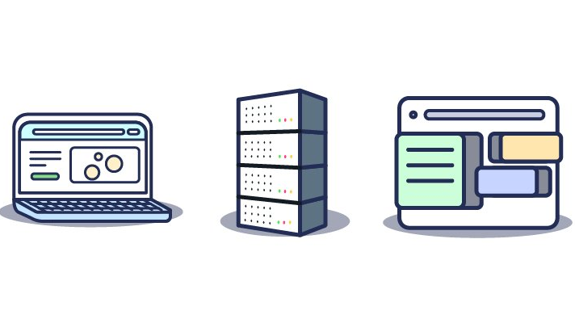
Types of Web Applications
Notes:
There are different types of web applications with different behaviors depending on how they’re built.
While all these web application types still use web technologies they generally fall under the categories of client-side, server-side, or single-page applications.

Slide 23
Client-Side Web Apps
Front-end development
User Interface (UI) and User Experience (UX)
Notes:
Client-side web apps are dominant in front-end development, meaning the user interface (UI) is the focus of these types of apps.
They tend to prioritize UX and bring users high-performance levels.
Any data or business logic that the app might use to function is dynamically loaded at start-up.
As a result of client-side loadinng, there is little to no wait time for loading a page.
This speeds up interactions with content, making the page more responsive.

Slide 24
Server-Side Web Apps
Back-end development
More secure
More browser compatibility
Notes:
Server-side software is essentially synonymous with back-end development.
Back-end development is composed of building the databases, servers, application programming interfaces (APIs), and any other background processes that occur in an application.
Though server-side applications by and large still display content and UIs, the most dynamic of code resides in the web server.
Server-side rendering (SSR) works well with static content as it can take some time for the web browser to send a request to the server and await an answer.
On the bright side, server-side web apps are normally more secure and offer more browser compatibility than client-side web apps.

Slide 25
Single-Page Apps
Only one page
Notes:
A single-page application (SPA) differs from a traditional multi-page application where new pages load only when you click a link.
Instead, SPAs have desirable advantages of both client-side apps and server-side apps.
SPAs wield their power from only one page, typically deploying an infinite scroll mechanism to display all its content.
Despite the fact that server-side rendering holds associations with long wait times,
JavaScript frameworks that have build in features to fetch only the data that is necessary at any given time.
SPAs can be build in a way so that they do not require the entire page to reload in order to execute an action or fetch new data.

Slide 26
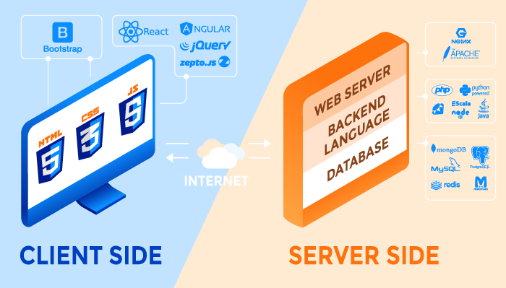
Web Apps Frameworks & Other Technologies
Notes:
For full-stack web app development, your business will need the right front-end and back-end tools to see the process through.
The frameworks and technologies below will be very useful for building your web app.

Slide 27
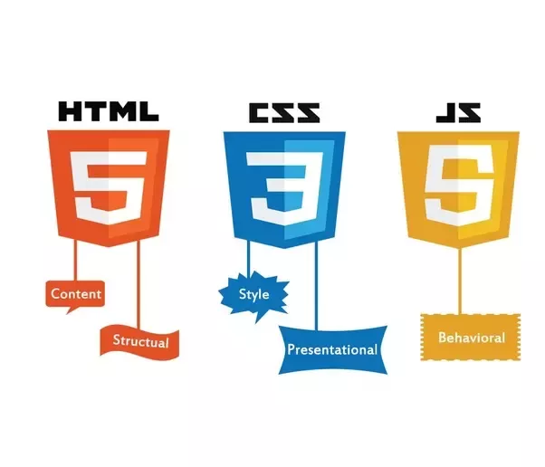
Front-End
Notes:
On the front-end, the tools you should use for web app development have remained roughly the same for a quarter of a century. But at the very least, you can bet they’re reliable!
JavaScript
JavaScript is the principal client-side programming language for any type of web development.
And nearly all web developers use JavaScript for coding client-side behaviour into their website or web application.
This is because JavaScript allows developers to build dynamic websites.
Basic functionality like scrolling bars and clickable buttons are all the result of JavaScript programming.
Since JavaScript originated the language has expanded greatly, and it now has many use cases and frameworks.
HTML
HTML is another core technology of web development. HyperText Markup Language (HTML) is responsible for structuring the content of a web page.
A series of HTML elements describe to a web page how to display text, images and any other content
CSS
Cascading Style Sheets (CSS) is a language for denoting the presentation of a web page. Just like JavaScript and HTML, it is a foundation technology making the World Wide Web what it is today.
Colors, layouts, and fonts are some of the integral characteristics of a web page or web app. CSS invokes these characteristics.

Slide 28
Exercise
Open any website
Open developer tools
Explore HTML and CSS

Slide 29
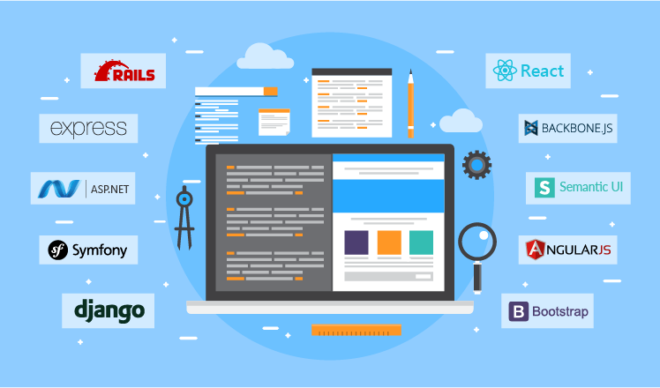
Front-End Frameworks
Bootstrap
React.js
Angular.js
Backbone
Semantic-UI
Notes:
Frameworks are, in short, libraries that help you develop your application faster and smarter!
They lay a foundation for your app and assist with many things
Some client-side frameworks are
Choosing a framework depends specific capabilities of different client-side frameworks. Since they vary in the scope of functionality supported, look for the one that fits the needs of your future web app.

Slide 30
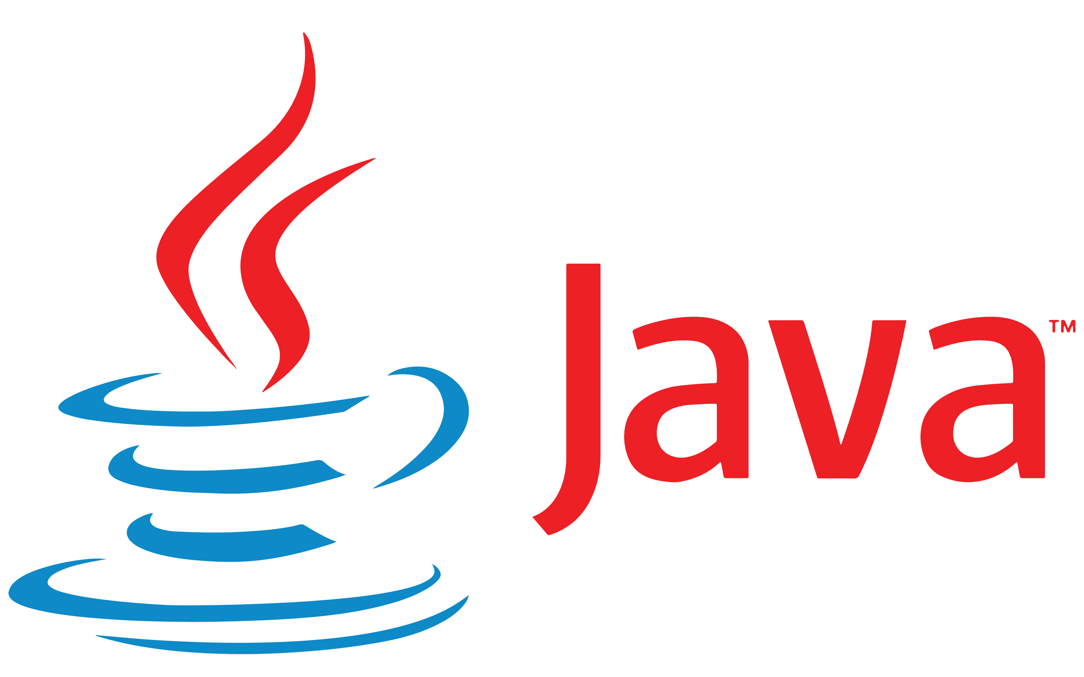


Back-End
Programming Languages
Notes:
Back-end development features a wider range of technologies as back-end development comprises several components such as server-side programming, databases, web servers, and APIs.
Programming Languages
Server-side or back-end programming languages must handle the functionality of a web app that takes place behind the scenes.
Back-end web development can involve working with databases to send and receive data from one end to the other, managing user connections and security authentications, and ultimately empowering the web application to perform as it should.
Java, Python, Ruby, and PHP are some of the most popular back-end languages. Many tech companies use more than just one of these languages but still, many side-by-side comparisons exist to examine their utility.
There are also back-end web frameworks to simplify software development. Django and Ruby on Rails have become increasingly well-known in the web development community.

Slide 31
Back-End Frameworks
Symfony (PHP)
Django (Python)
Express (Node.js/JavaScript)
Ruby on Rails (Ruby)
ASP.NET (C#)
Notes:
Although front end has evolved, it’s first and foremost job is to display an interface, and without app logic any UI/UX is irrelevant. That’s why server-side frameworks are important.
Among the most popular MVC-based server-side web frameworks are:
By using either of these server-side web application frameworks, you let it handle HTTP requests, database control and management, as well as URL mapping.
using client-side frameworks to introduce more user-engaging features and responsiveness.

Slide 32

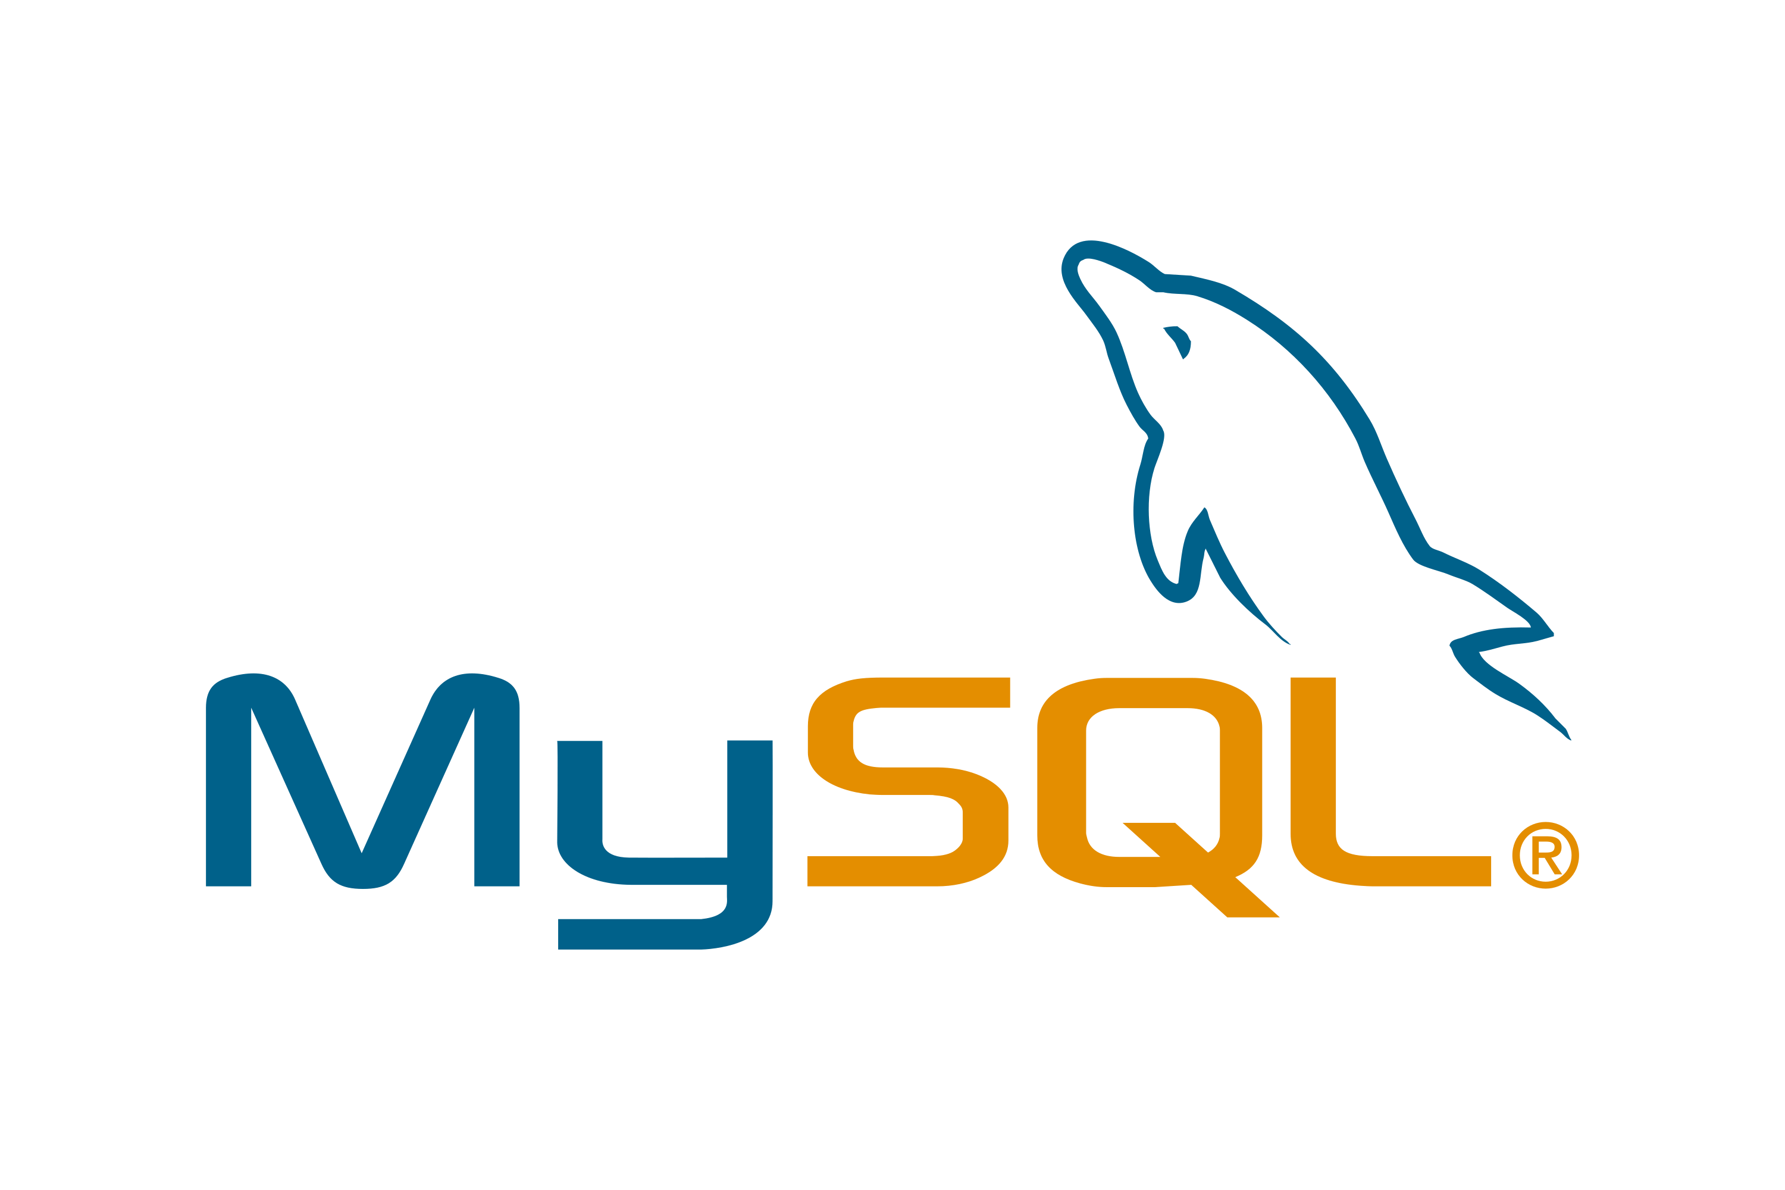


Back-End
Databases
Notes:
Databases
Databases store the data of an application. Back-end developers should be familiar with query languages that are able to request and retrieve data using queries.
Structured Query Language (SQL) is the go-to query language for the common web developer. SQL has many extensions or related versions extending additional functionality like MySQL, PostgreSQL, and Oracle.

Slide 33


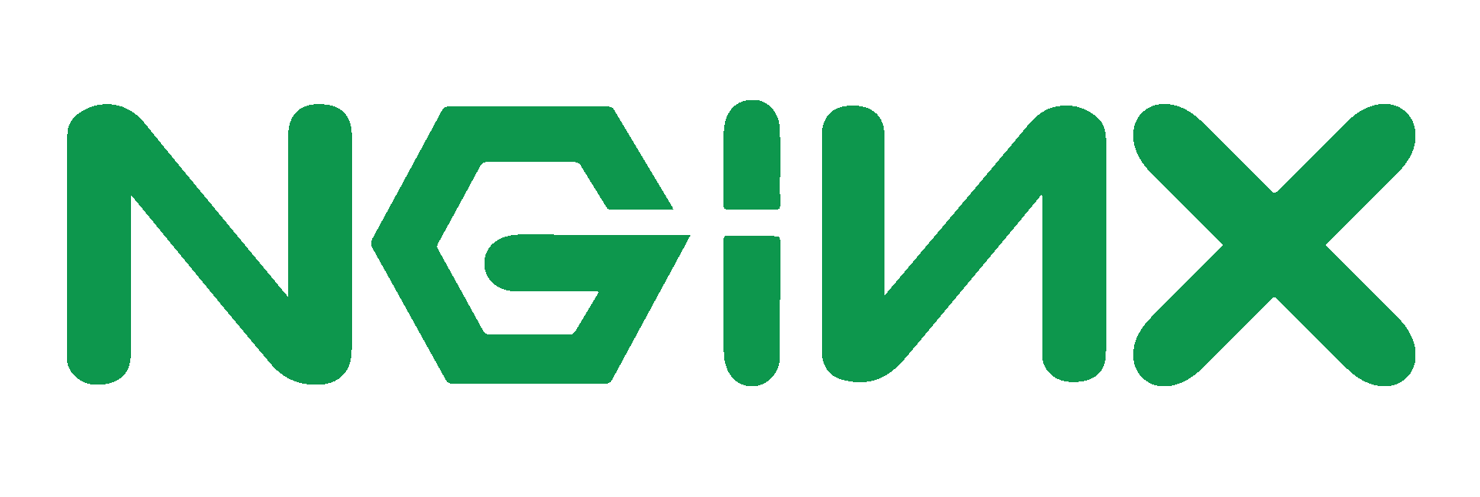
Back-End
Servers
Notes:
Servers
Servers respond to network requests. Through the internet connection of a web application, a server retrieves information based on client requests and then serves the client — that is, you, your computer, or mobile device — whatever it is that you asked for.
While there isn’t a specific language for servers, all of the technologies that make up back-end development should absolutely have a good relationship with the servers they work with.
Web servers of note include Apache, Nginx, and Internet Information Services (IIS).

Slide 34
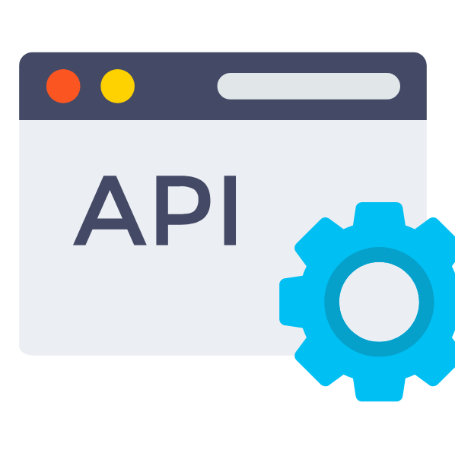
Back-End
Application Programming Interface (API)
Notes:
APIs
This is a bridge used for data transference between architecture components (back end, front end, and the server
APIs facilitate connections between two or more software systems. An API integration is what fuels your Google Home’s communication with your Spotify playlist, for instance, or eBay’s collaboration with PayPal.
Again, APIs do not have a domain-specific language. Instead, developers create APIs using other back-end technologies and share them publicly with other developers or keep them closed to the organization they work for.

Slide 35
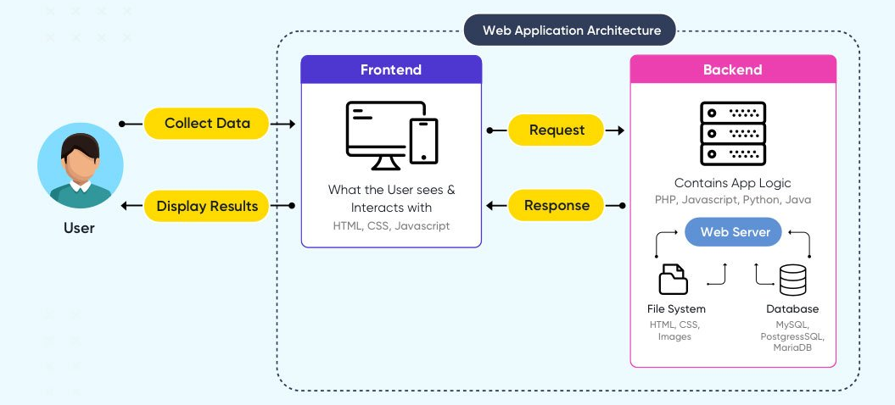
How it comes together?
API

Slide 36
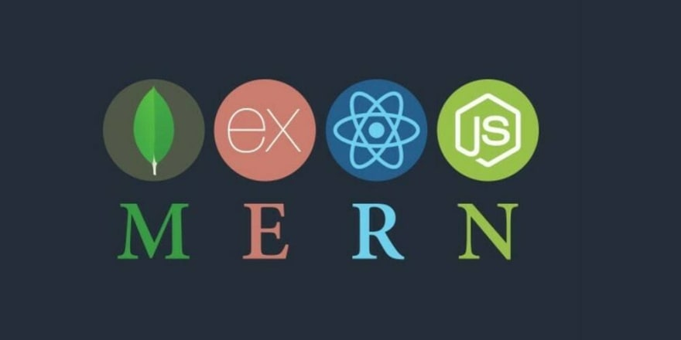
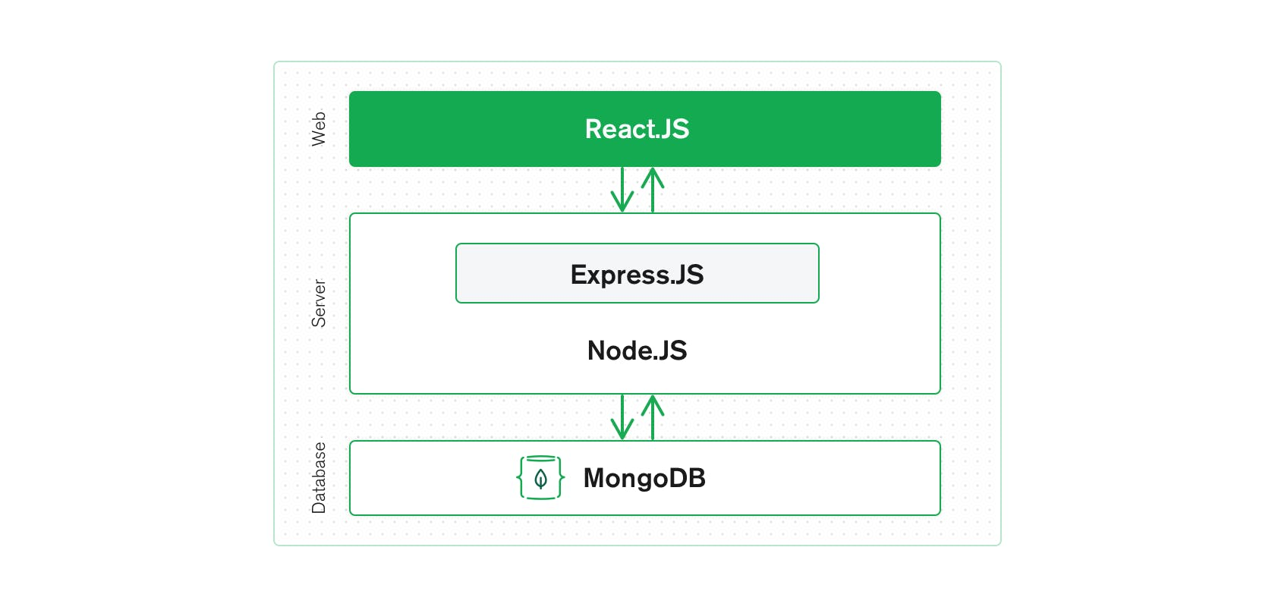
MERN Stack
Notes:
MERN Stack is a Javascript Stack that is used for easier and faster deployment of full-stack web applications. MERN Stack comprises of 4 technologies namely: MongoDB, Express, React and Node.js. It is designed to make the development process smoother and easier.
Each of these 4 powerful technologies provides an end-to-end framework for the developers to work in and each of these technologies play a big part in the development of web applications.
MongoDB - document database
Express(.js) - Node.js web framework
React(.js) - a client-side JavaScript framework
Node(.js) - the premier JavaScript web server
Also MEAN stack
Don’t have to context switch coz all JS

Slide 37
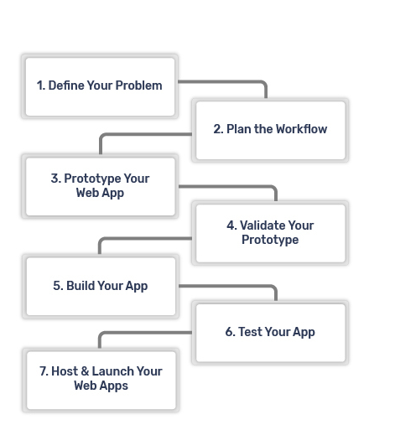
7 Steps To Developing Web Applications
Notes:
To be frank, web application development is not altogether different from any other software development life cycle.
A great team and well-defined procedures are nearly always what drive successful development.

Slide 38

1. Define Your Problem
Notes:
Defining the problem you wish to solve or identifying exactly why you want consumers to use your web app is the first step in developing your web application.
People come up with new ideas all the time but is an idea really worth implementing if it doesn’t provide clever solutions to an existing issue?
Finding a genuine app idea

Slide 39
2. Plan the Workflow
Notes:
A workflow can establish a means of systematic organization for the various aspects of your web application development.
Think about what your web app will consist of and how to meet those requirements using your resources and budget.
Because this is software development, your workflow should be both business-oriented and technical.
Adjust accordingly for the time frame in which you want your web app development to be completed.

Slide 40
3. Prototype Your Web App
Notes:
Prototyping involves building an incomplete yet functional application to better understand what your final product might look like.
In software development, a prototype is akin to a minimum viable product (MVP).

Slide 41
4. Validate Your Prototype
Notes:
The idea is that your prototype should be impressive enough to give you the validation you need to continue your project knowing that people are already interested in what you have in store.
To do this, validate your prototype by presenting your web app to potential users. Gather feedback and work from there.

Slide 42
5. Build Your App
Notes:
Research the software you should have ready at the helm to build your app.
Consider which front-end and back-end frameworks and technologies can competently fulfill the requirements of your project.
Once you have found all your tools, it’s time to start developing.
Build your web app!

Slide 43
6. Test Your App
Notes:
Hopefully, testing your web application goes without saying.
Many software development teams administer tests throughout the development life cycle, ensuring that each iteration of your web app is bug-free.
Software quality assurance is likewise an important part of building a web application.
And this should happen before you release your app to the public.

Slide 44
7. Host & Launch Your Web Apps
Notes:
In the same fashion as a website, a web app must be hosted on a web server.
That means putting your web app into action requires purchasing a domain name and a hosting provider on the cloud.

Slide 45

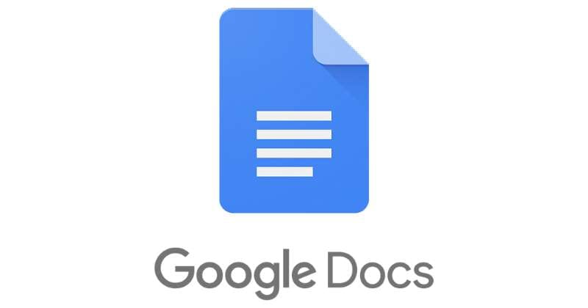
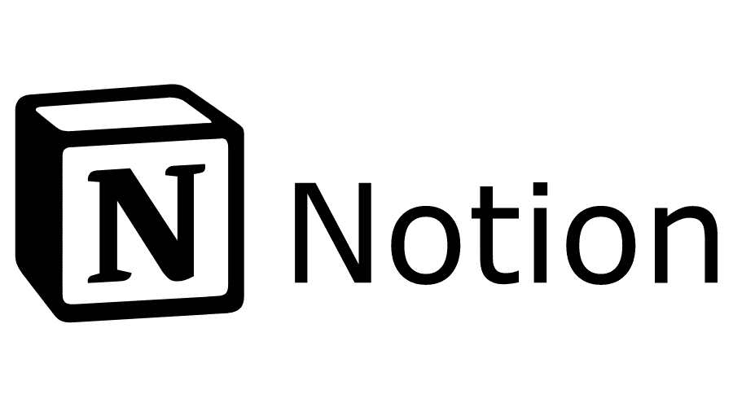
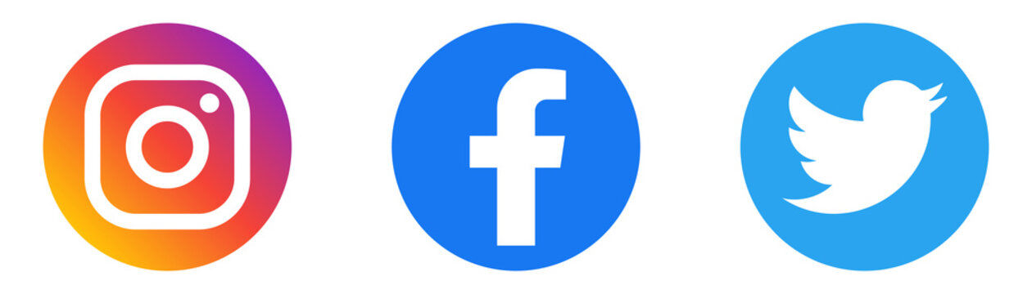

Examples of Web Applications
Notes:
Web applications are all around you. Learning how you use web apps from day to day can inspire the motivating concept behind your own web app.
Google Docs
Google Docs is the most infamous of this list. Via Google Docs, users can interact directly with the web app by editing and making suggestions on documents.
One of the noteworthy features of Google Docs is that it automatically saves any edits you make right after you make them. It’s almost impossible to lose your work.
Notion
Notion is gaining popularity quickly. It’s a web application that satisfies many needs and purposes. You can use Notion as a calendar, to-do list, notepad, wiki, and more.
The app operates using components that you can insert and make changes to from the convenience of your web browser.

Slide 46
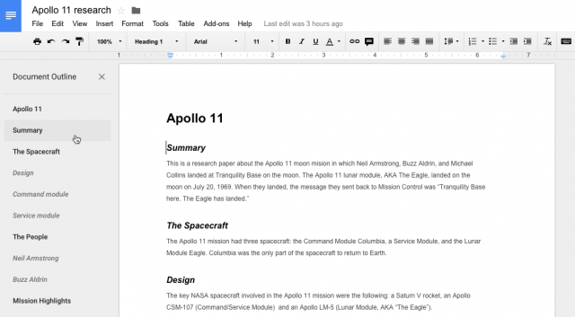
Notes:
2. Google Docs
Google Docs, believe it or not, is a web application. It is also available as a mobile application. Created in 2012, Google Docs was born from the acquisition of a number of other web applications, and is great for creating, reading, updated, and deleting documents 😉

Slide 47
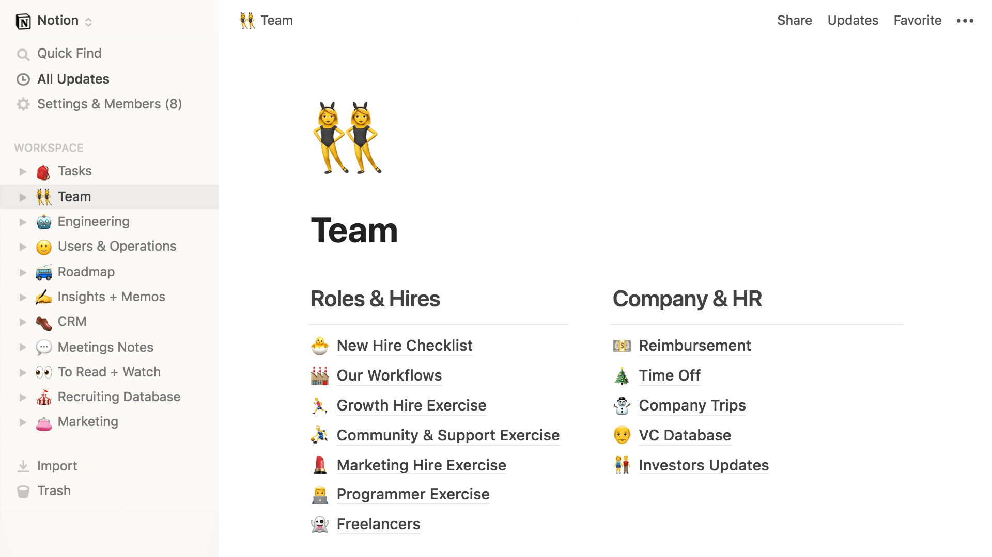
Notes:
3. Notion
Notion is an all-in-one, note-taking and collaboration web application with markdown support. The product was released in 2016 and is fast becoming a staple in many small businesses.

Slide 48

Web App

